Slide 1
Mobile Computing
CS 325 – Mobile Computing
Prepared by Michael L. Estal

Slide 2
Objectives
At the end of this lesson, the student should able to:
Define mobile technologies in terms of hardware, software, and communications.
Utilize the mobile computing nomenclature tor describe and analyze existing mobile computing frameworks and architectures.
Evaluate the effectiveness of different mobile computing frameworks.
Describe how mobile technology functions to enable other computing technologies.

Slide 3
Definition of Terms
Computing – is any goal-oriented activity requiring, benefiting from, or creating computers. It includes development of both hardware and software.

Slide 4
Definition of Terms
There are 2 aspects of mobile computing
Mobility – refers to as users who have access to similar communication services at different places.
Example: User can have a mobile and he can login to his mail account from any desktop to check or compose emails.
Device Portability – refers to the movement of a communication device with or without a user.

Slide 5
Definition of Terms
Mobile Computing– is a technology that allows transmission of data, voice and video via a computer or any other wireless enabled device without having to be connected to a fixed physical link.
Mobility– refers to as users who have access to similar communication services at different places. Example: user can have a mobile and he can login to his mail account from any desktop to check or compose mails.

Slide 6
Components of Mobile Computing
The main concept involves –
Mobile Communication
Mobile Hardware
Mobile Software

Slide 7
Mobile Communication
Mobile communications refers to a form of communications which does not depend on a physical connection between the sender and receiver and who may move from one physical location to another during communication.
* The infrastructure put in place to ensure that seamless and reliable communication goes on.

Slide 8
Characteristics of Communication Device
Fixed and wired: the devices are fixed at a position, and they are connected through a physical link to communicate with other devices.
Fixed and wireless: the devices are fixed at a position, and they are connected through a wireless link to make communication with other devices.
Mobile and wired: some devices are wired, and some are mobile. They altogether make communication with other devices.
Mobile and wireless: the devices can communicate with each other irrespective of their position. They can also connect to any network without the use of any wired device.

Slide 9
Wired vs Wireless
Wired Networks
high bandwidth
low bandwidth variability
can listen on wire
high power machines
high resource machines
need physical access (security)
low delay
connected operation
Wireless Networks
low bandwidth
high bandwidth variability
hidden terminal problem
low power machines
low resource machines
need proximity
higher delay
disconnected operation

Slide 10
Mobile Hardware
Mobile hardware includes mobile devices or device components that receive or access the service of mobility. They would range from portable laptops, smartphones, tablet Pc’s, Personal Digital Assistants.
* Typically hardware components of a mobile phone include display (LCD, touch screen), keypad, microphone, speaker, SIM Card, battery, USB port, antenna, memory unit (RAM,ROM), e.t.c

Slide 11
Mobile Software
A mobile Software, most commonly referred to as an app, is a type of application software designed to run on a mobile device, such as a smartphone or tablet computer. Mobile
* Software frequently serve to provide users with similar services to those accessed on

Slide 12
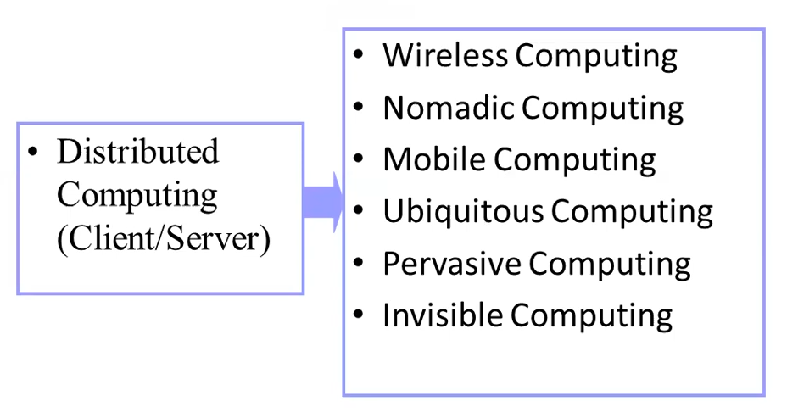
Different Forms of Computing

Slide 13
Supportive Technologies
Wireless Communication networks
Multiple networks “covering” the globe
World-wide deregulation and spectrum actions
Standard communication system and air link interfaces
Portable information appliances
Laptops, notebooks, sub-notebooks, and MNCs
Hand-held computers
PDAs and Smartphones
Internet:
TCP/IP & de-facto application protocols
Ubiquitous web content

Slide 14
Mobile Computing
Using:
Small size portable computers, hand-helds MNC, and other small wearable devices,
To run stand-alone applications (or access remote applications) via:
Wireless networks: IR, Bluetooth, W-LANs, Cellular, W-Packet Data networks, SAT. etc.
By:
Nomadic and mobile users (animals, agents, trains, cars, cell phones, …)

Slide 15
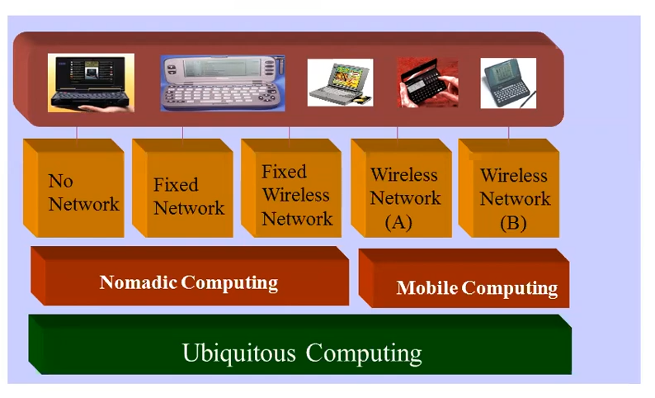
Nomadic, Mobile & Ubiquitous

Slide 16
Nomadic, Ubiquitous
Nomadic computing is the use of mobile computing technology to connect to the global internet or use specific data resources from a stored location while moving around from one place to another.
Nomadic computing is also known as mobile computing.

Slide 17
Nomadic, Ubiquitous
Ubiquitous computing is not a specific technology, but a scenario in which computers become more numerous and fade into the background, providing information to human users and embedding intelligence and computing capabilities in seemingly everyday objects.

Slide 18
Nomadic vs. Mobile
Mobile most commonly refers to access in motion and is therefore unrestricted to a given geographic location. Mobile may also, however, refer to access in a fixed location via equipment that users can relocate as required, but is stationary while in operation. This mode of operation is often called nomadic computing.

Slide 19
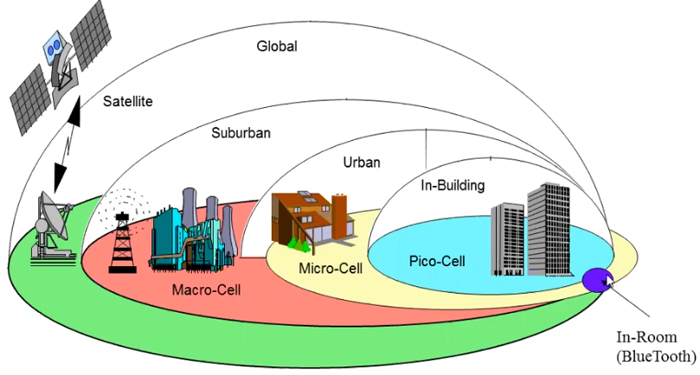
Wireless Infrastructure at a glance

Slide 20
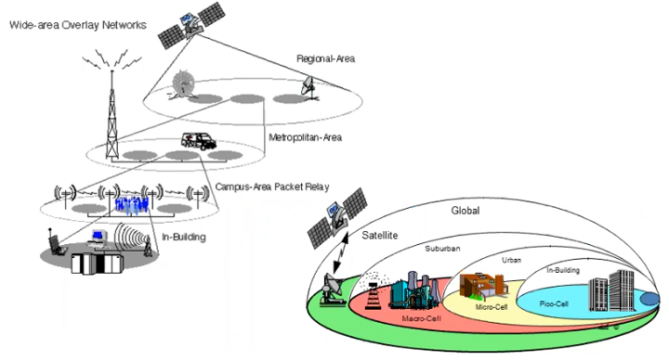
Wireless Network Overlay

Slide 21
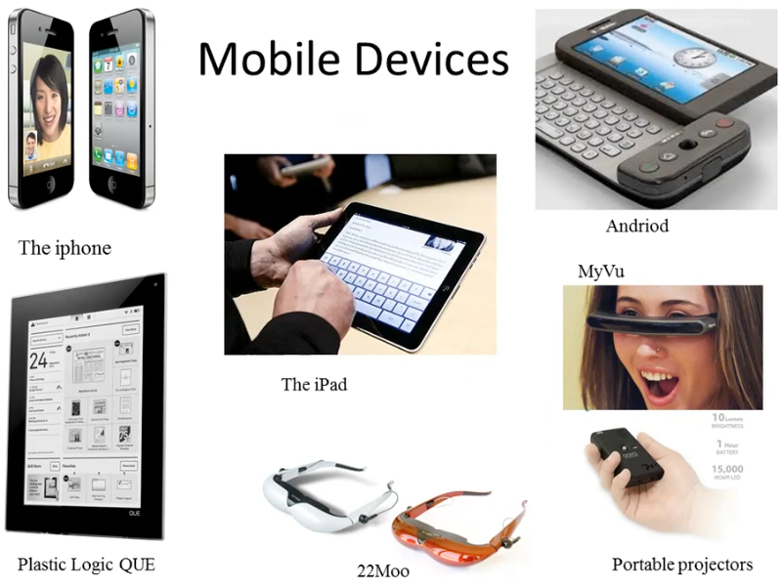

Slide 22
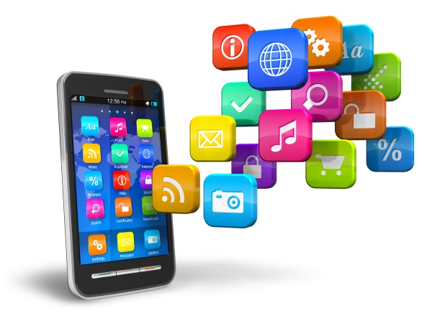
Mobile Softwares

Slide 23
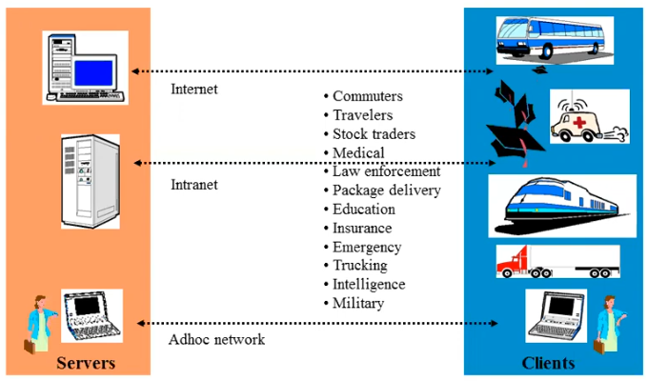
Applications of Mobile Computing

Slide 24
Advantages of Mobile Computing
Location Flexibility. This has enabled users to work from anywhere as long as there is a connection established…
Saves Time…
Enhanced Productivity…
Ease of Research…
Entertainment…
Streamlining of Business Processes.

Slide 25
LIMITATIONS OF MOBILE COMPUTING
Resource constraints: Battery.
Interference: Radio transmission cannot be protected against interference using shielding and result in higher loss rates for transmitted data or higher bit error rates respectively.
Bandwidth: Although they are continuously increasing, transmission rates are still very low for wireless devices compared to desktop systems. Researchers look for more efficient communication protocols with low overhead.
Dynamic changes in communication environment: variations in signal power within a region, thus link delays and connection losses.

Slide 26
LIMITATIONS OF MOBILE COMPUTING (cont.)
Network Issues: discovery of the connection-service to destination and connection stability.
Interoperability issues: the varying protocol standards.
Security constraints: Not only can portable devices be stolen more easily, but the radio interface is also prone to the dangers of eavesdropping. Wireless access must always include encryption, authentication, and other security mechanisms that must be efficient and simple to use.

Slide 27
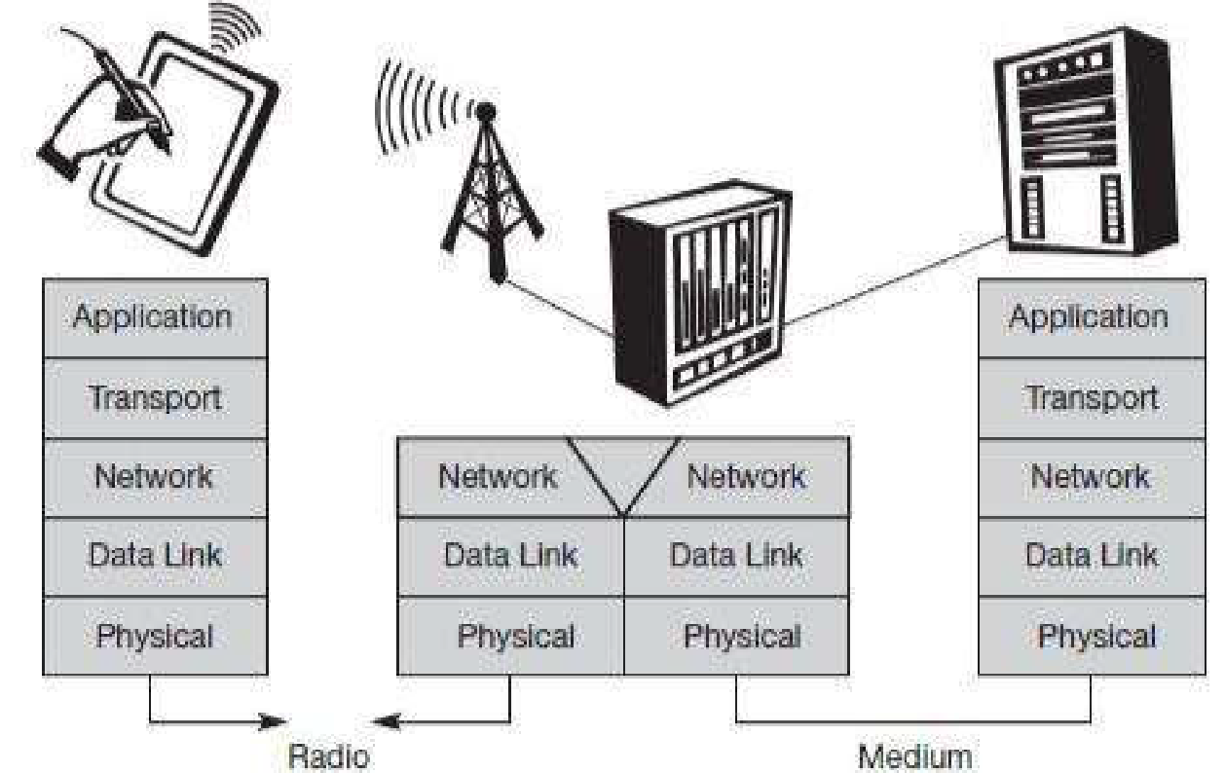
A Simplified Reference Model

Slide 28
A Simplified Reference Model
Physical layer: This is the lowest layer in a communication system and is responsible for the conversion of a stream of bits into signals that can be transmitted on the sender side. The physical layer of the receiver then transforms the signals back into a bit stream. For wireless communication, the physical layer is responsible for frequency selection, generation of the carrier frequency, signal detection (although heavy interference may disturb the signal), modulation of data onto a carrier frequency and (depending on the transmission scheme) encryption.

Slide 29
A Simplified Reference Model (cont.)
Data link layer: The main tasks of this layer include accessing the medium, multiplexing of different data streams, correction of transmission errors, and synchronization (i.e., detection of a data frame). Altogether, the data link layer is responsible for a reliable point-to-point connection between two devices or a point-to-multipoint connection between one sender and several receivers.

Slide 30
A Simplified Reference Model (cont.)
Network layer: This third layer is responsible for routing packets through a network or establishing a connection between two entities over many other intermediate systems. Important functions are addressing, routing, device location, and handover between different networks.
Transport layer: This layer is used in the reference model to establish an end-to-end connection. Quality of service, flow and congestion control are relevant, especially if the transport protocols known from the Internet, TCP and UDP, are to be used over a wireless link.

Slide 31
A Simplified Reference Model (cont.)
Application layer: Finally, the applications (complemented by additional layers that can support applications) are situated on top of all transmission oriented layers. Functions are service location, support for multimedia applications, adaptive applications that can handle the large variations in transmission characteristics, and wireless access to the world-wide web using a portable device.

Slide 32
GLOBAL SYSTEM FOR MOBILE COMMUNICATIONS (GSM)
GSM is the most successful digital mobile telecommunication system in the world today. It is used by over 800 million people in more than 190 countries. GSM permits the integration of different voice and data services and the interworking with existing networks. Services make a network interesting for customers. The primary goal of GSM was to provide a mobile phone system that allows users to roam throughout Europe and provides voice services compatible to ISDN and other PSTN systems.

Slide 33
Why Go Mobile?
Enable anywhere/anytime connectivity
Bring computer communications to areas without pre-existing infrastructure
Enable mobility
Enable new applications
An exciting new research area

Slide 34
Evolution
Mobile computing can be categorized into seven major categories of focus
These categories are the basis for the technology that is used today in research and design of mobile computing
Each category or section is a different area that was focused on making mobile computing what it is today
These seven categories are: Portability, Miniaturization, Connectivity, Convergence, Divergence, Apps, Digital Ecosystems

Slide 35
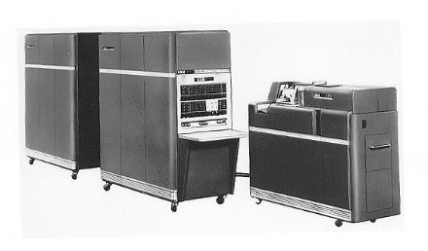
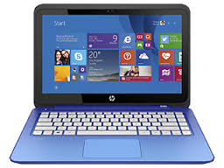
Portability
Reducing the size of hardware to enable the creation of computers that could be physically moved around relatively easily

Slide 36
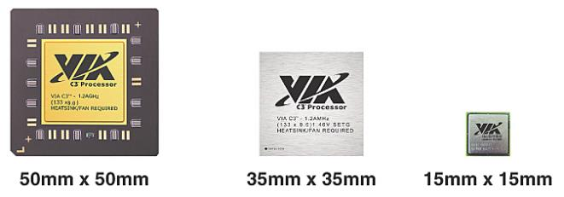
Miniaturization
Creating new and significantly smaller mobile form factors that allowed the use of personal mobile devices while on the move

Slide 37
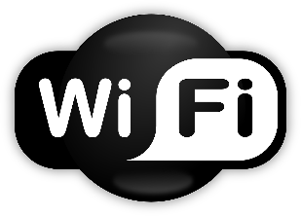
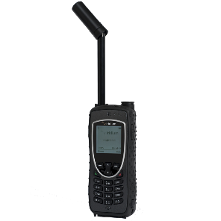
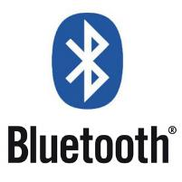
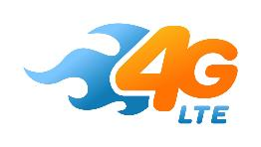
Connectivity
Developing devices and applications that allowed users to be online and communicate via wireless data networks while on the move

Slide 38
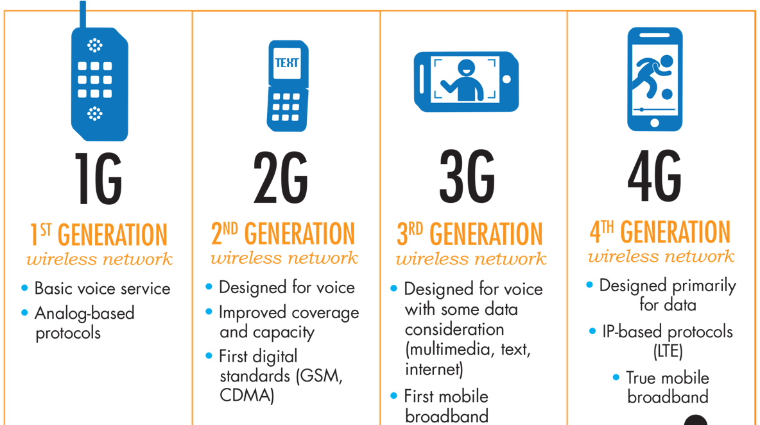
Mobile Evolution

Slide 39
1G: Voice Only
Cell phones began with 1G technology in the 1980s. 1G is the first generation of wireless cellular technology. 1G supports voice only calls.
1G is analog technology, and the phones using it had poor battery life and voice quality, little security, and were prone to dropped calls.
The maximum speed of 1G technology is 2.4 Kbps.

Slide 40
2G: SMS and MMS
Cell phones received their first major upgrade when their technology went from 1G to 2G. This leap took place in Finland in 1991 on GSM networks and effectively took cell phones from analog to digital communications.
The 2G telephone technology introduced call and text encryption, along with data services such as SMS, picture messages, and MMS.
Although 2G replaced 1G and is superseded by later technology versions, it's still used around the world.
The maximum speed of 2G with General Packet Radio Service (GPRS) is 50 Kbps. The speed is 1 Mbps with Enhanced Data Rates for GSM Evolution (EDGE).

Slide 41
2.5G and 2.75G: Data, Finally
2.5G introduced a new packet-switching technique that was more efficient than 2G technology. This led to 2.75G, which provided a theoretical threefold speed increase. AT&T was the first GSM network to support 2.75G with EDGE in the U.S.
2.5G and 2.75G were not defined formally as wireless standards. They served mostly as marketing tools to promote new cell phone features to the public.

Slide 42
3G: More Data, Video Calling, and Mobile Internet
The introduction of 3G networks in 1998 ushered in faster data-transmission speeds, so you could use your cell phone in more data-demanding ways such as for video calling and mobile internet access. The term "mobile broadband" was first applied to 3G cellular technology.
Like 2G, 3G evolved into the much faster 3.5G and 3.75G as more features were introduced to bring about 4G.
The maximum speed of 3G is estimated to be around 2 Mbps for non-moving devices and 384 Kbps in moving vehicles.

Slide 43
4G LTE: The Current Standard
The fourth generation of networking, which was released in 2008, is 4G. It supports mobile web access like 3G does and also gaming services, HD mobile TV, video conferencing, 3D TV, and other features that demand high speeds.
The max speed of a 4G network when the device is moving is 100 Mbps. The speed is 1 Gbps for low-mobility communication such as when the caller is stationary or walking.
Most current cell phone models support both 4G and 3G technologies.

Slide 44
5G: Coming Soon
5G is a not-yet-implemented wireless technology that's intended to improve on 4G.
5G promises significantly faster data rates, higher connection density, much lower latency, and energy savings, among other improvements.
The anticipated theoretical speed of 5G connections is up to 20 Gbps per second.

Slide 45
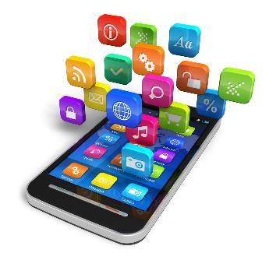
Convergence
Integrating emerging types of digital mobile devices, such as Personal Digital Assistants (PDAs), mobile phones, music players, cameras, games, etc., into hybrid devices

Slide 46
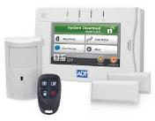
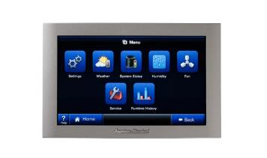
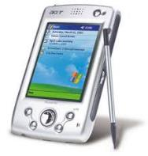
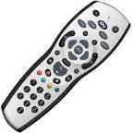
Divergence
Opposite approach to interaction design by promoting information appliances with specialized functionality rather than generalized ones

Slide 47
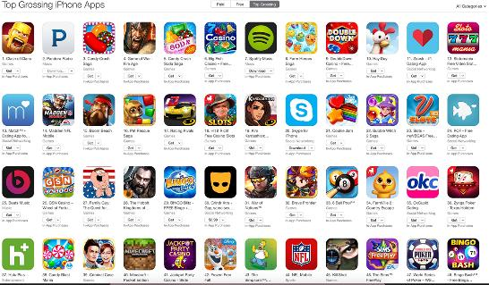
Applications (Apps)
The latest wave of applications (apps) is about developing matter and substance for use and consumption on mobile devices, and making access to this fun or functional interactive application content easy and enjoyable

Slide 48
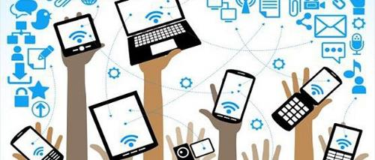
Digital Ecosystems
The emerging wave of digital ecosystems is about the larger wholes of pervasive and interrelated technologies that interactive mobile systems are increasingly becoming a part of

Slide 49
Example: Smartphone
Portability: carry it anywhere you want
Miniaturization: make it possible to build device to fit in your pocket
Connectivity: Wi-Fi, LTE/4G, cellular, Bluetooth
Convergence: phone, camera, gaming device, movie streaming, music player, …
Applications: “Rise of the Apps”
Digital Ecosystem: social networks, distributed gaming, video streaming, work apps, …

Slide 50
App Store (iOS)
2003: iTunes Music Store
2008: iPhone App Store (iPhone 3G with App Store support)
2015: > 100 billion app downloads
2016: > 2 million apps
2016: China biggest App Store market
2016: App developers earned $20 billions
Most downloaded app: Minecraft Pocket Edition (paid) and Pokemon GO (free)

Slide 51
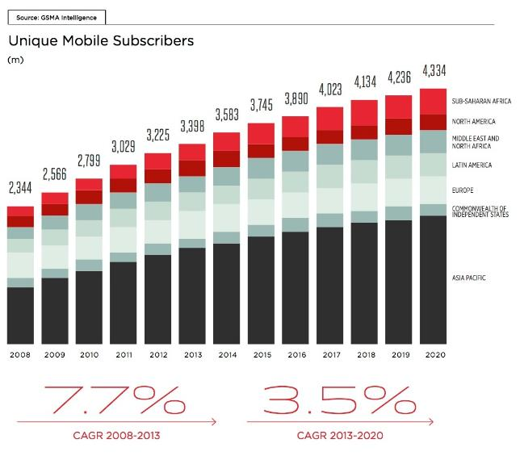
Trends in Mobile: Phone Subscribers

Slide 52
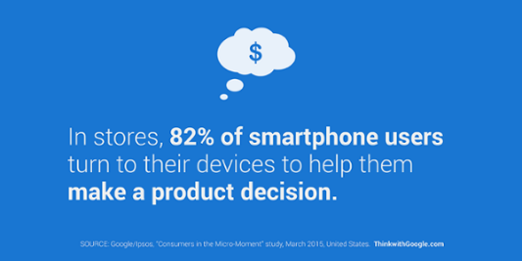
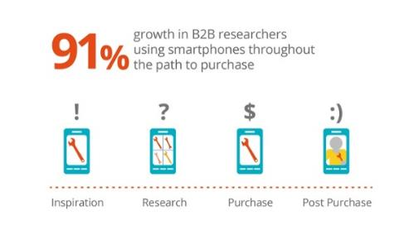
Trends in Mobile: Shopping

Slide 53
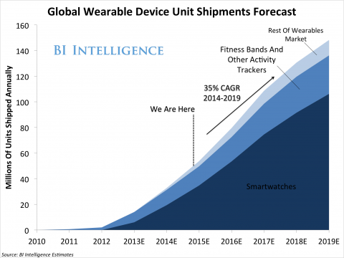
Trends in Mobile: Wearables

Slide 54
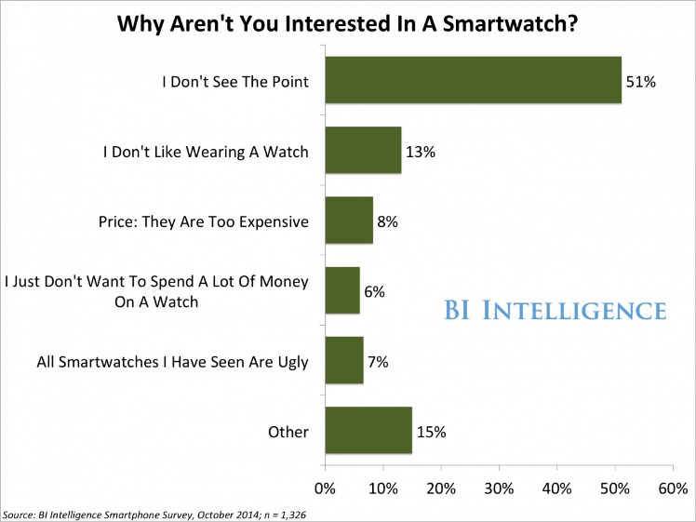
Trends in Mobile: Smartwatches

Slide 55
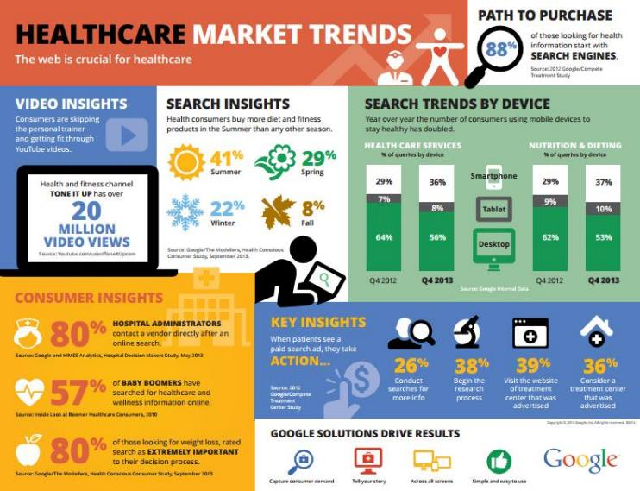
Trends in Mobile: Healthcare

Slide 56
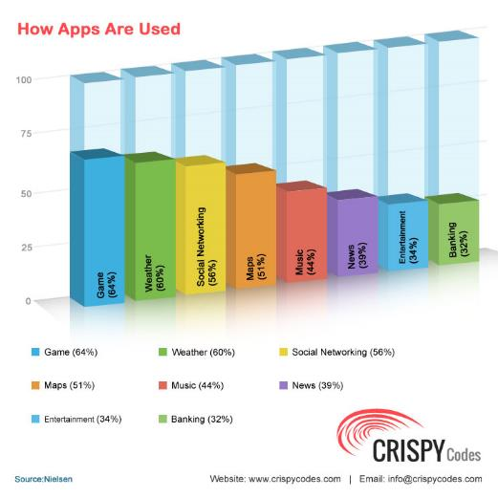
Trends in Mobile: Apps

Slide 57
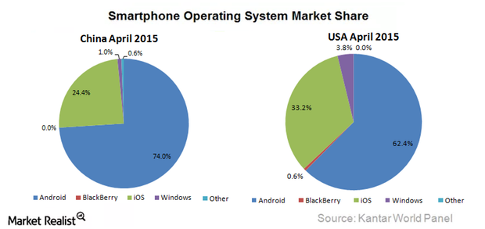
Trends in Mobile: Smartphone OS

Slide 58
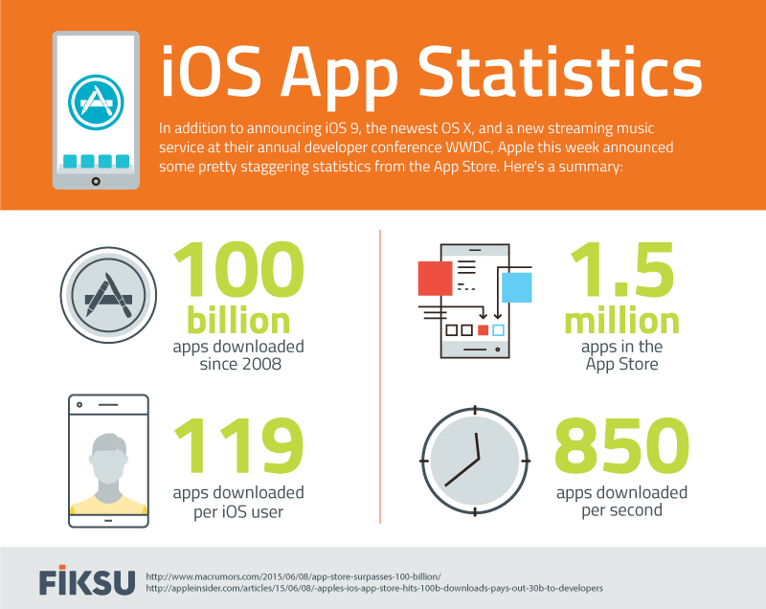
Trends in Mobile: Apps

Slide 59
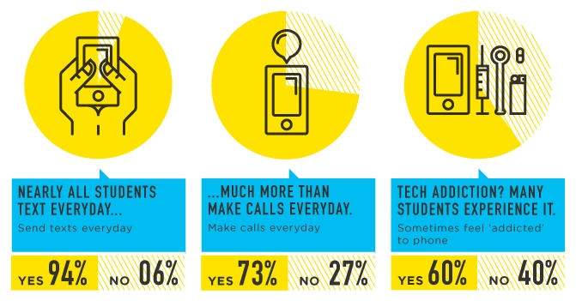
Trends in Mobile: Students

Slide 60
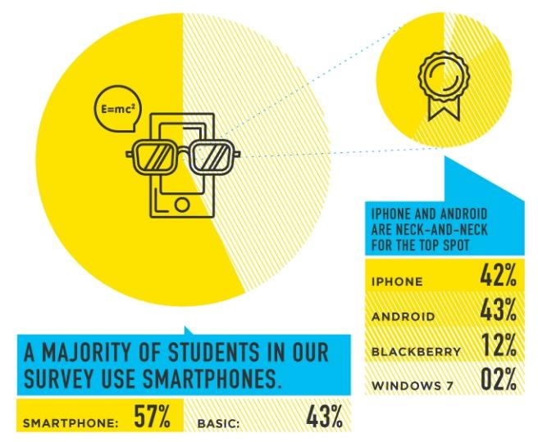
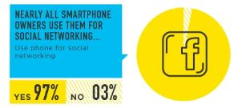
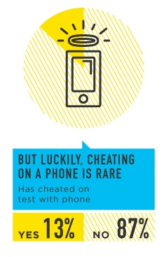
Trends in Mobile: Students

